Slide 1
Use your own dataset

Slide 2
Introduction
1. Generate your custom dataset with ‘npz’ file
2. Run logistic regression on this dataset
3. Run multi-layer perceptron on this dataset
4. Run convolutional neural network on this dataset

Slide 3
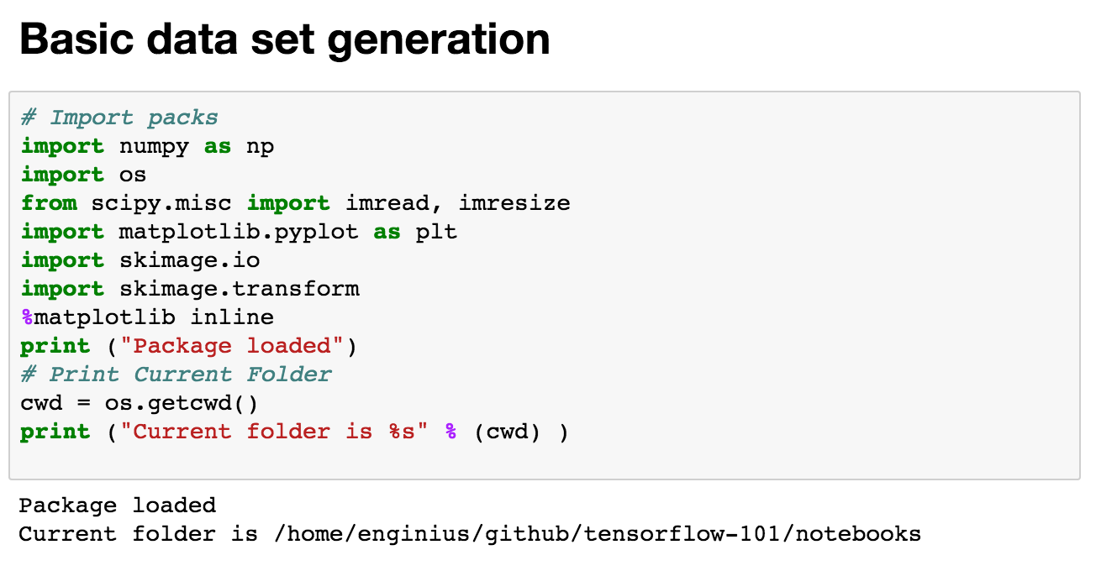
First, generate the ’dataset’

Slide 4
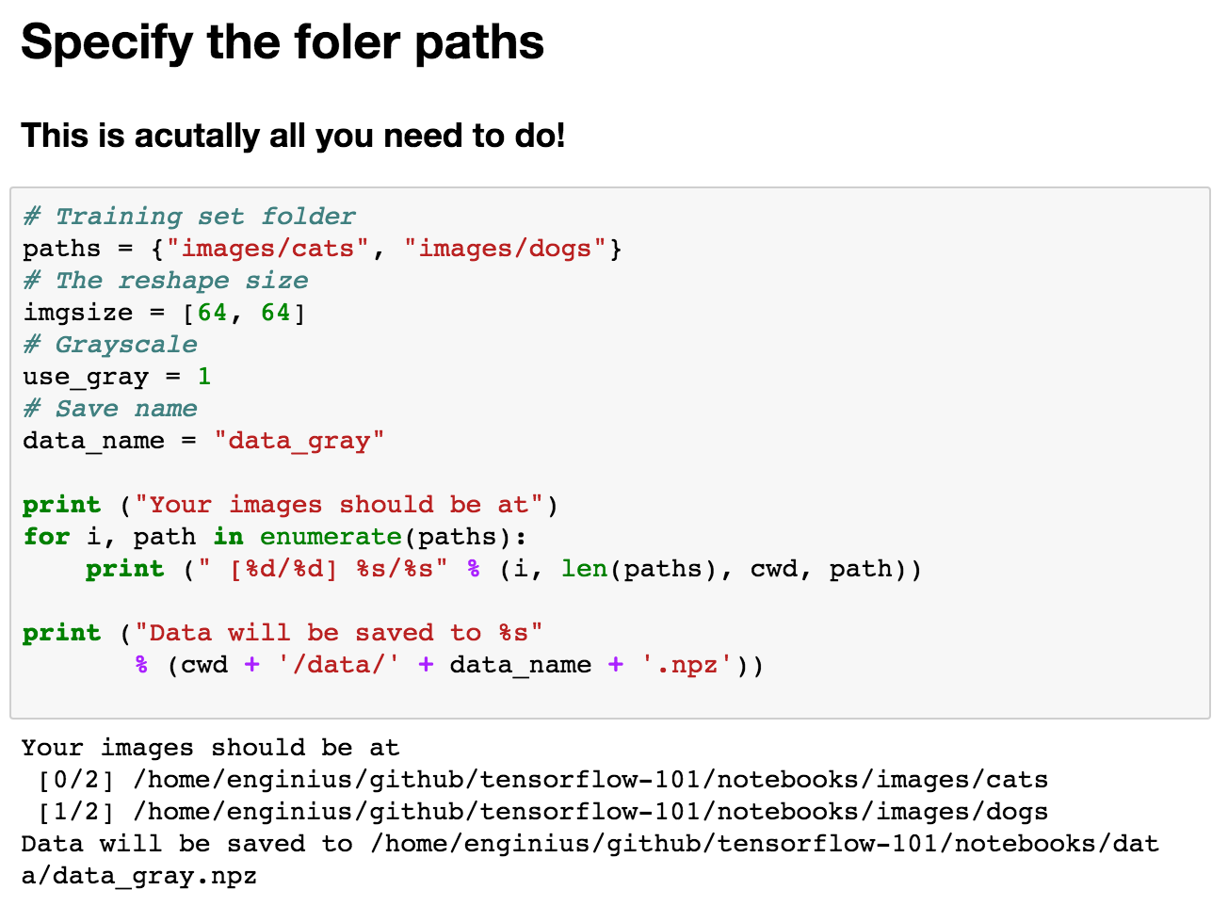
Specify folder locations

Slide 5
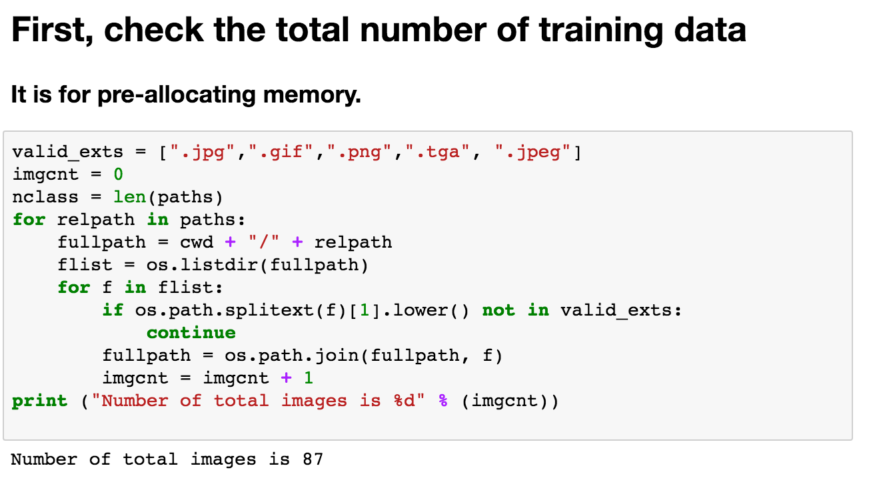
How many?

Slide 6
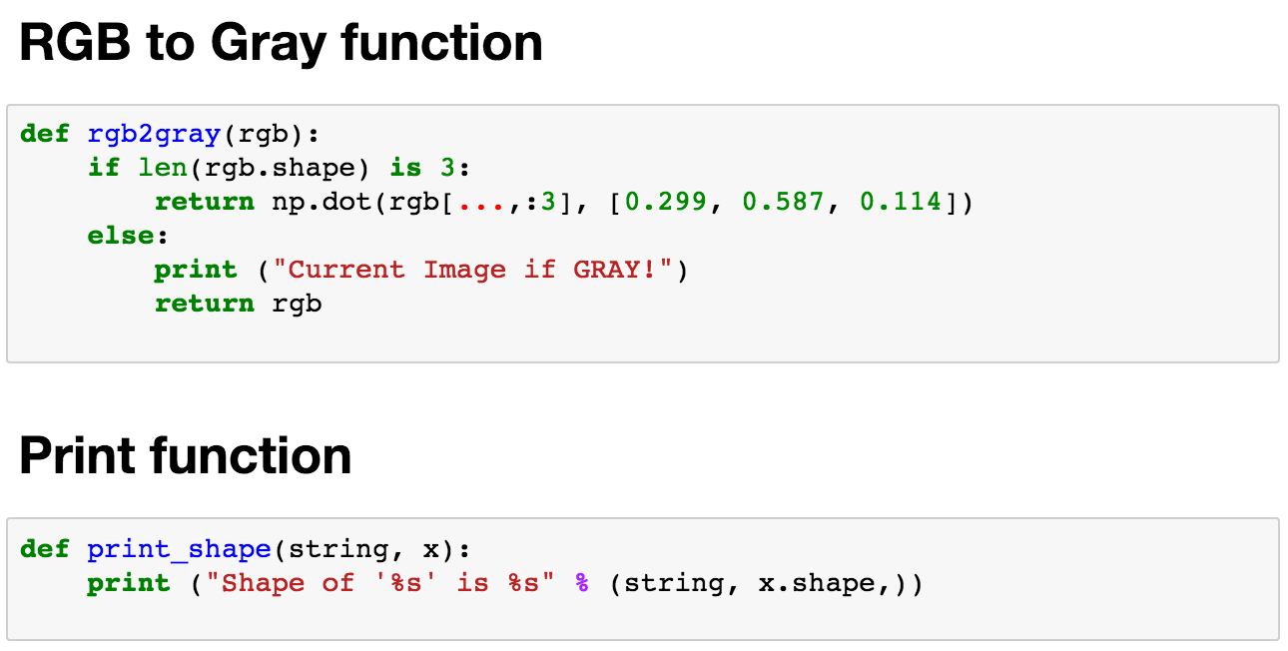
Helper functions

Slide 7
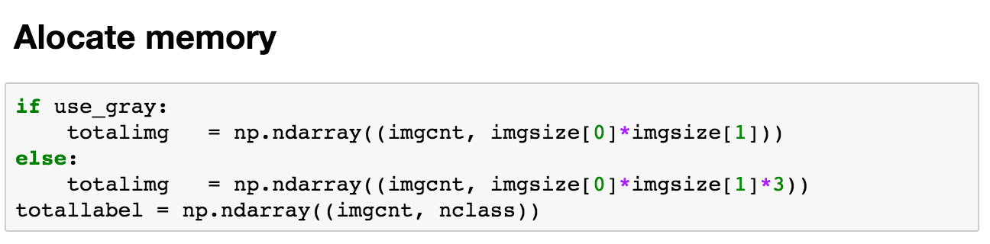
Make train and test datasets

Slide 8
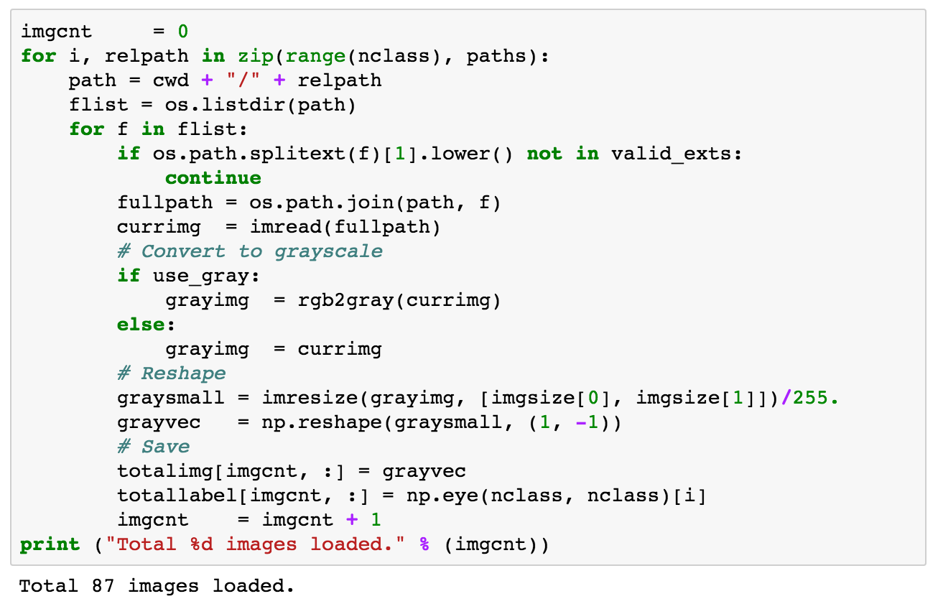
Loading process

Slide 9
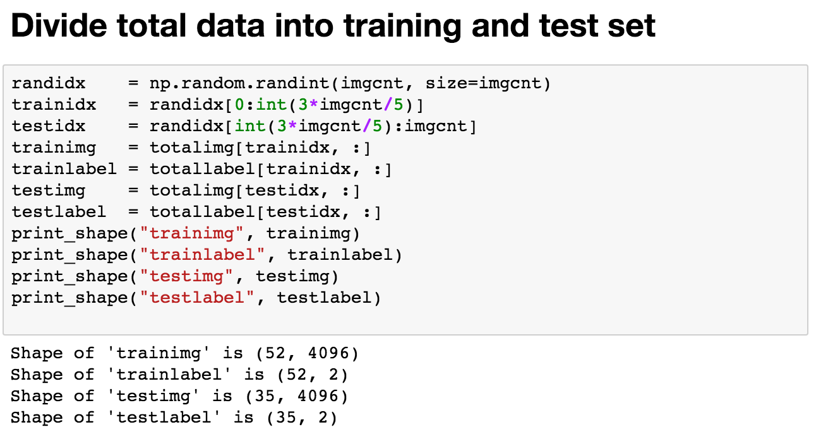
Divide

Slide 10
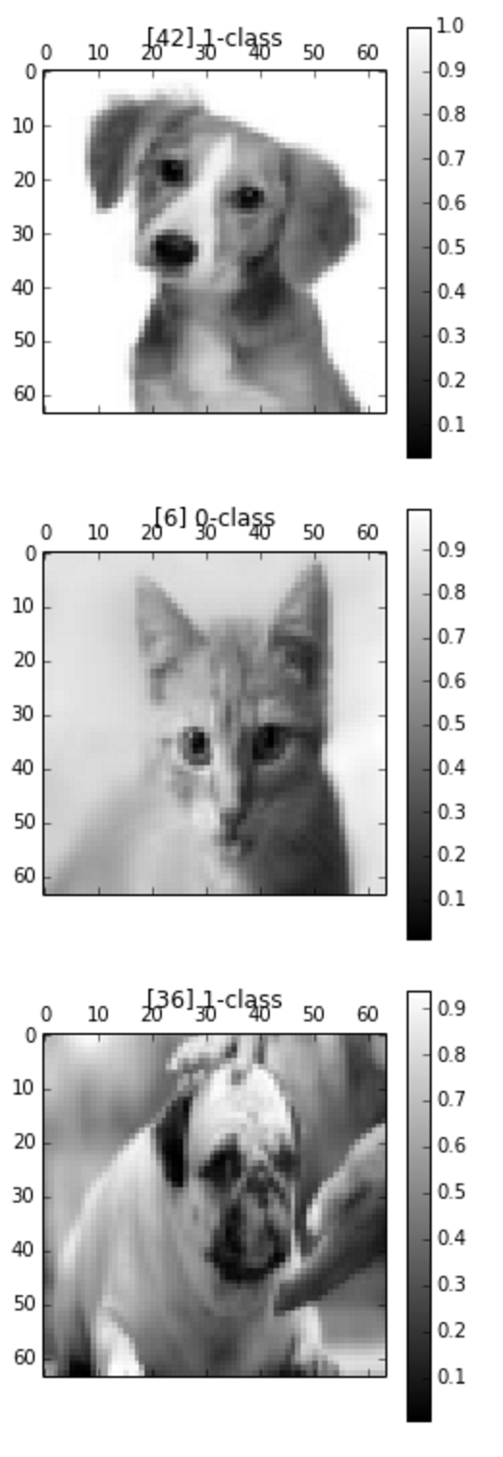
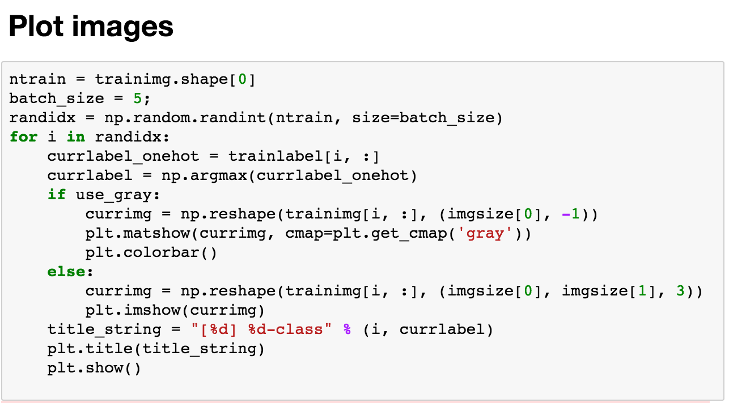
Let’s take a look

Slide 11
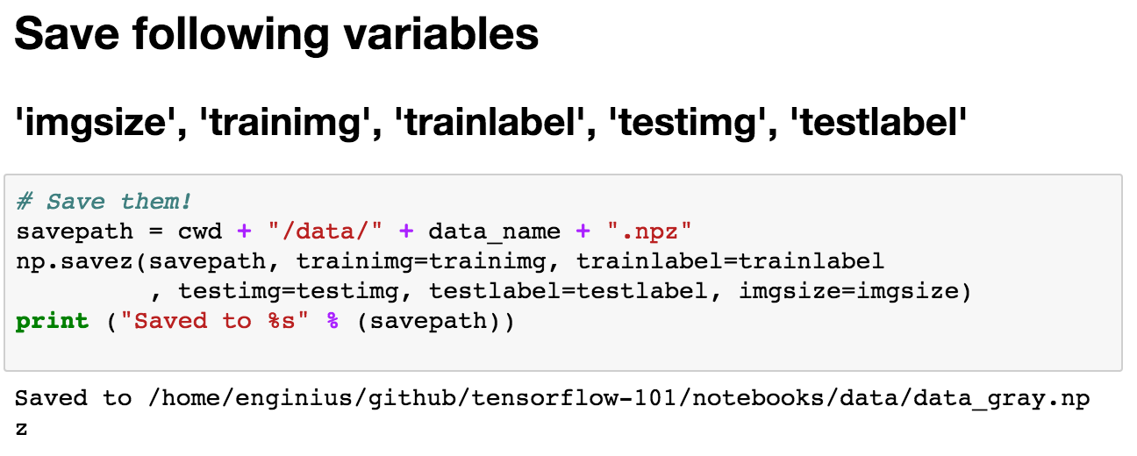
Save

Slide 12
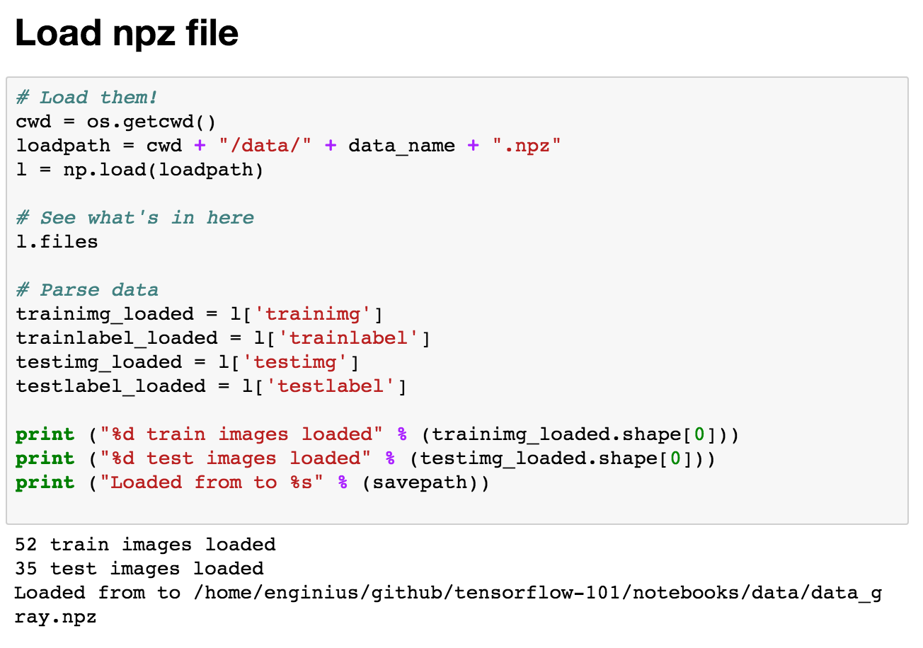
Load

Slide 13
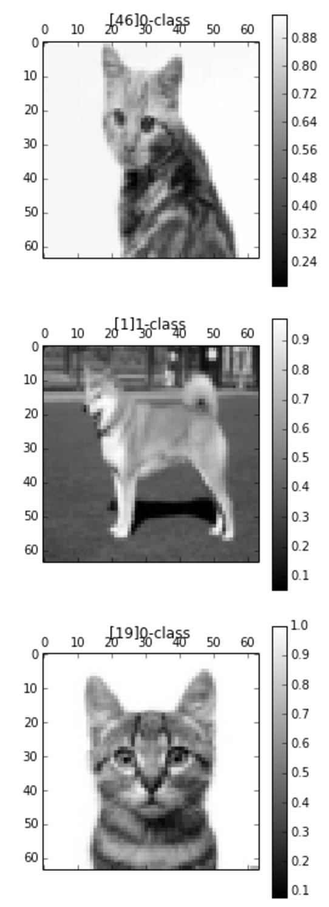
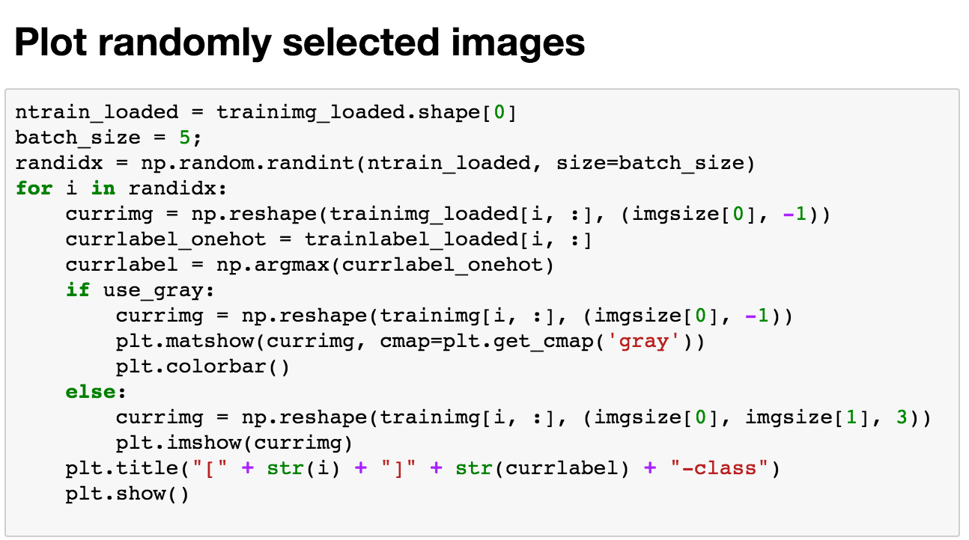
Plot again

Slide 14
Now, we have our own dataset

Slide 15
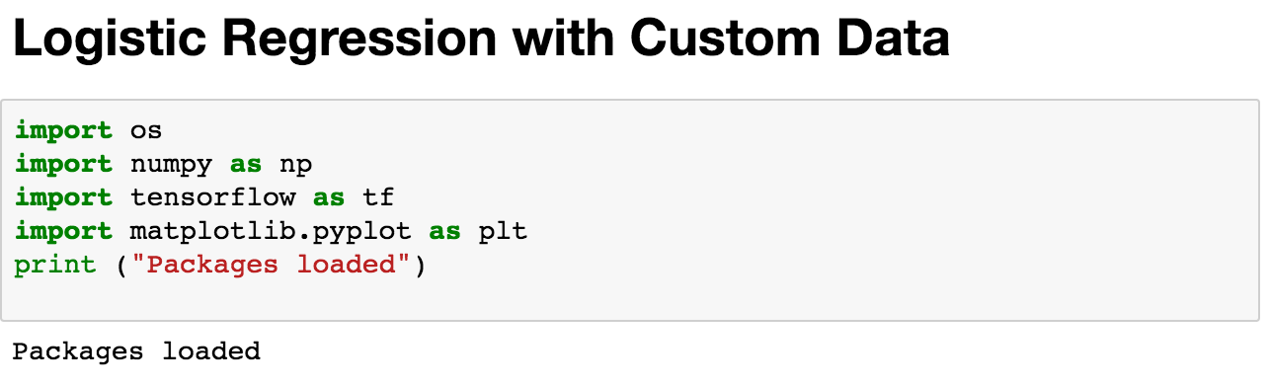
Logistic regression

Slide 16
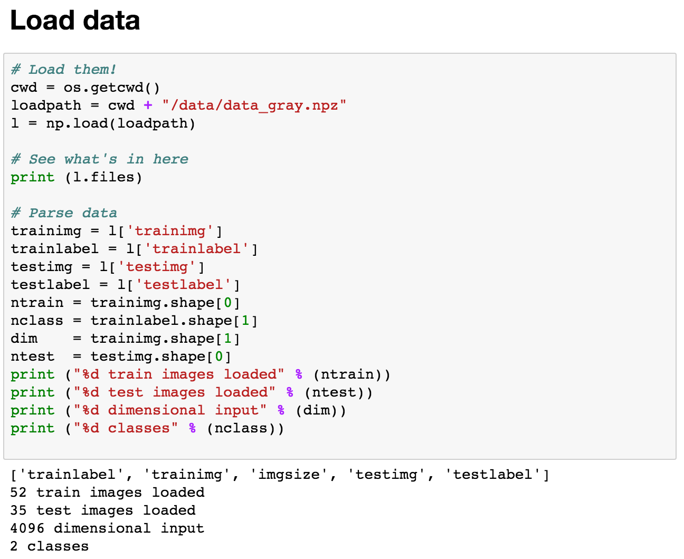
Load

Slide 17
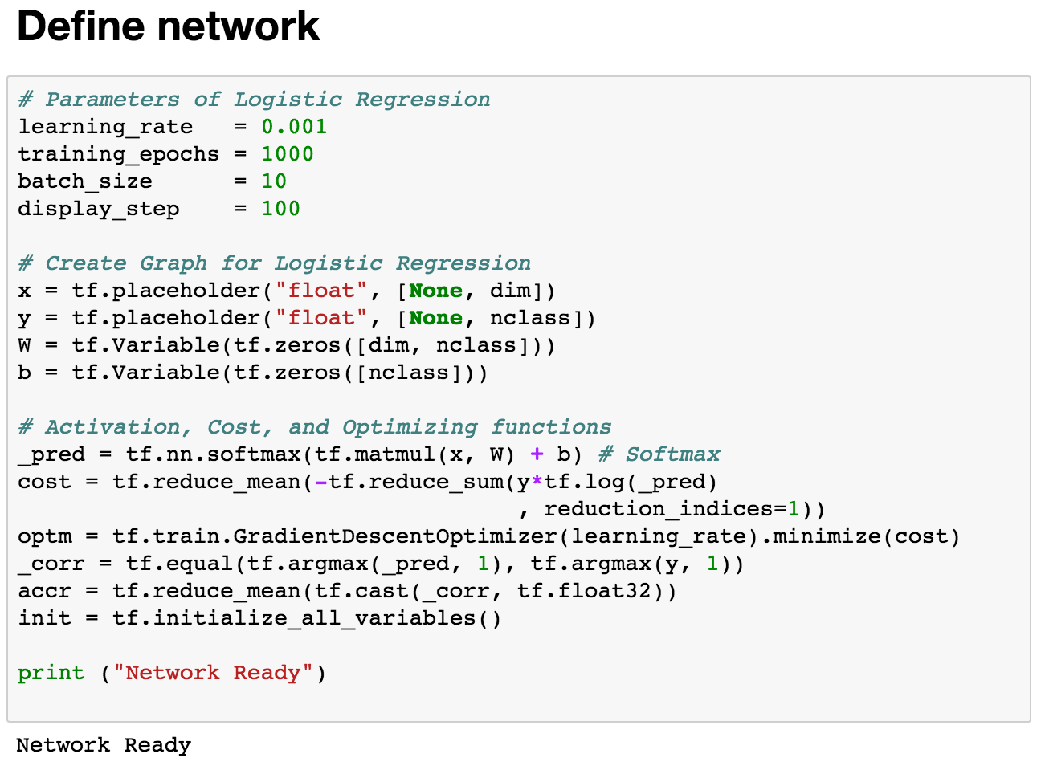
Define structure

Slide 18
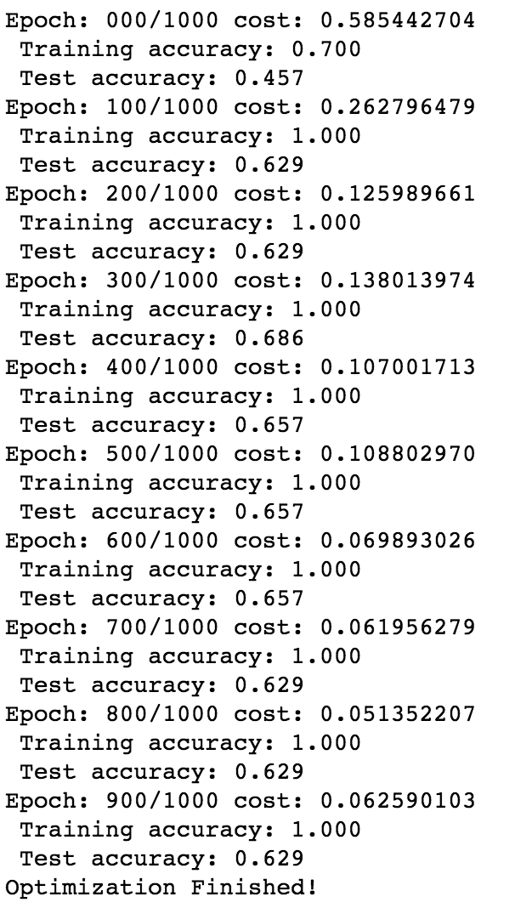
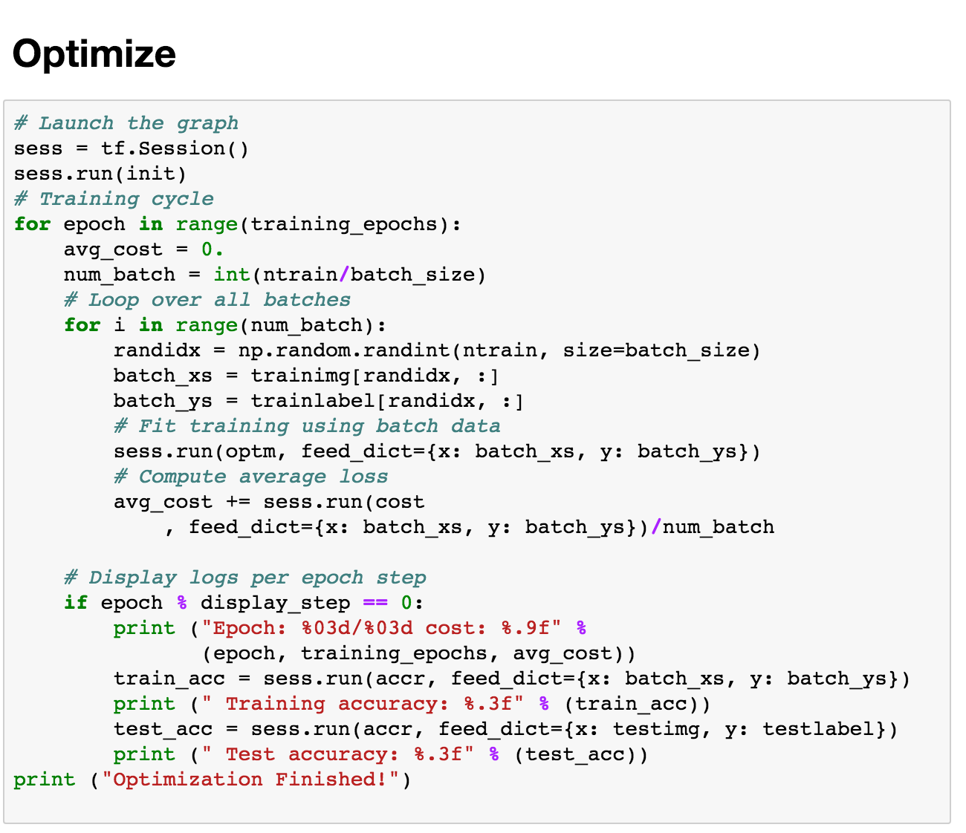
Run

Slide 19
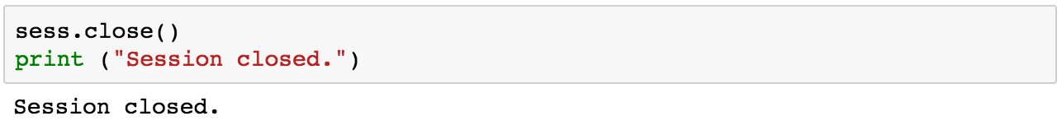
Close

Slide 20
Logistic regression
We got 77.1% accuracy on our own test dataset
One interesting thing to notice is that we got 100% accuracy on our own training dataset
Clear sign of overfitting!

Slide 21
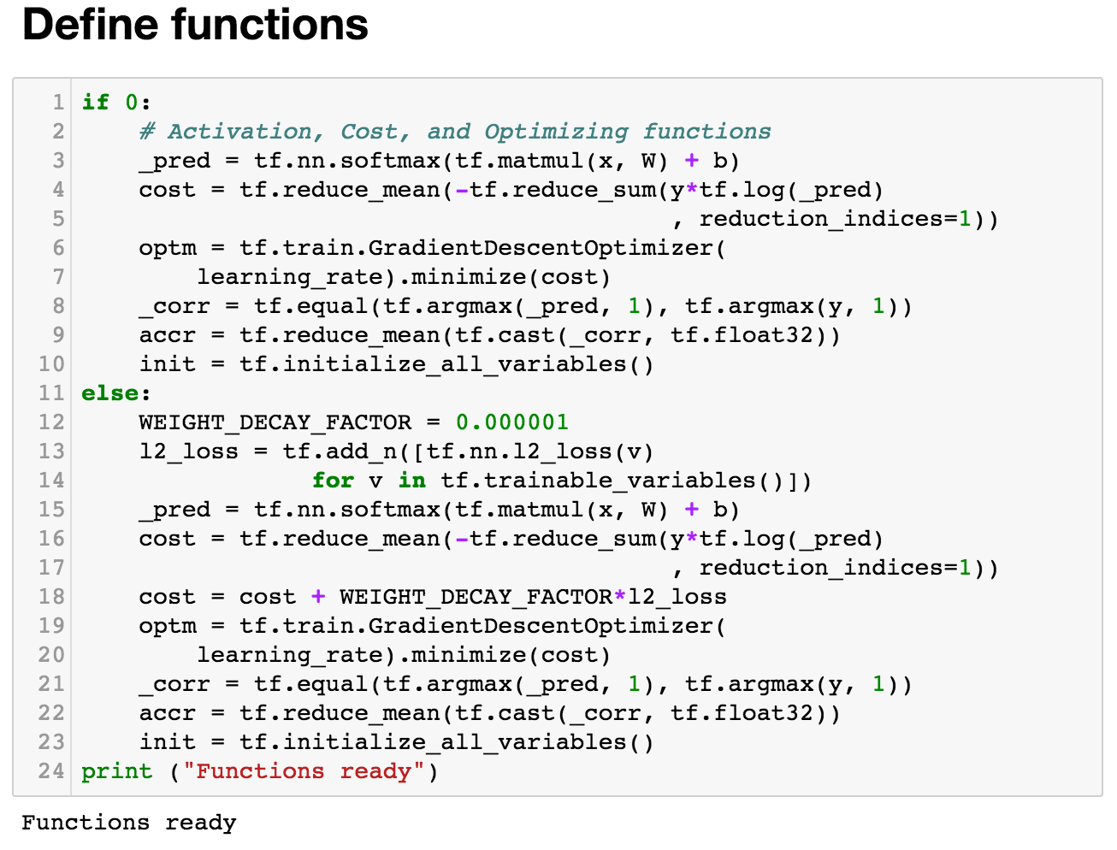
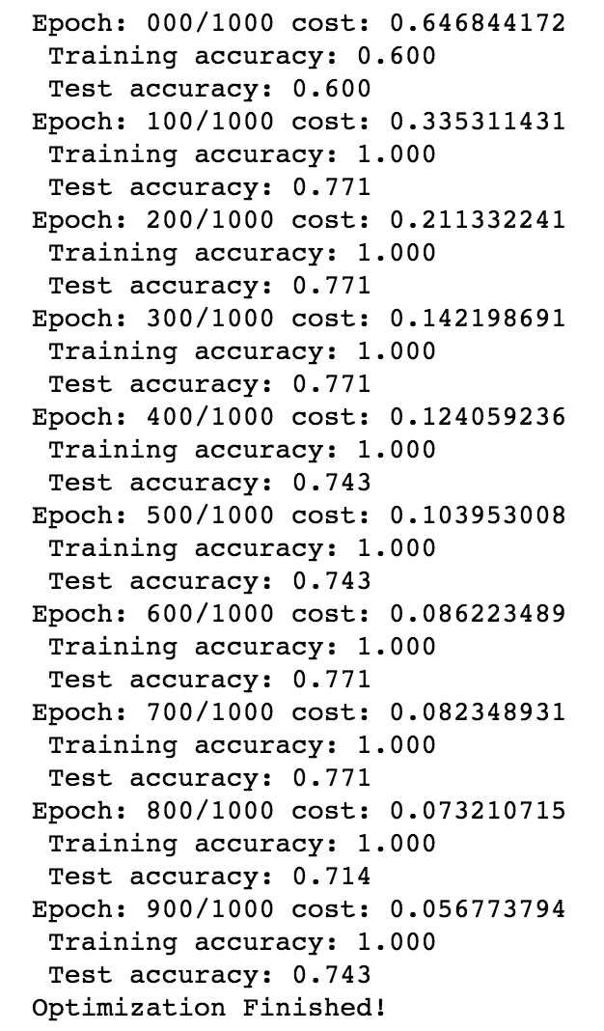
Weight decay

Slide 22
Lesson here

Slide 23
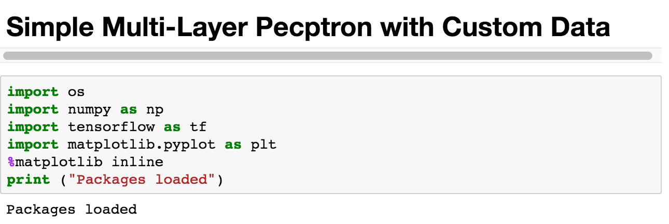
Multi layer perceptron

Slide 24
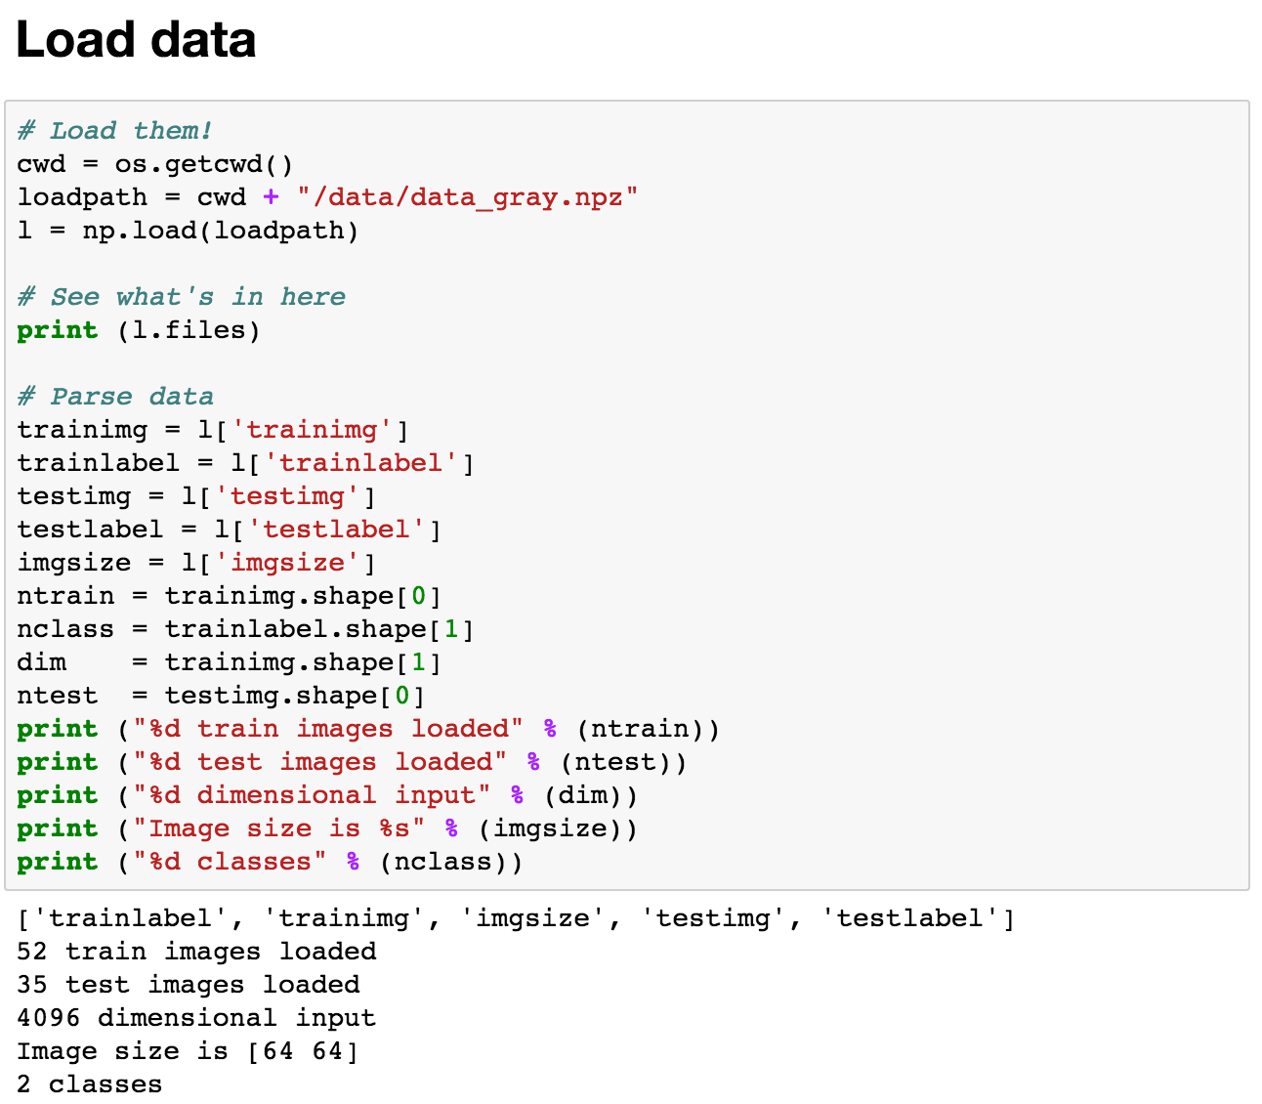
Load

Slide 25
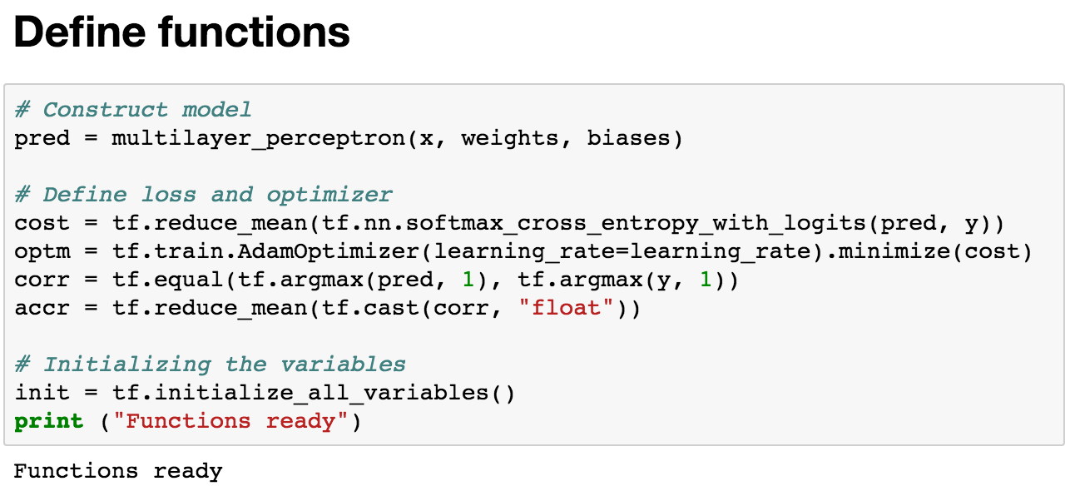
Networks

Slide 26
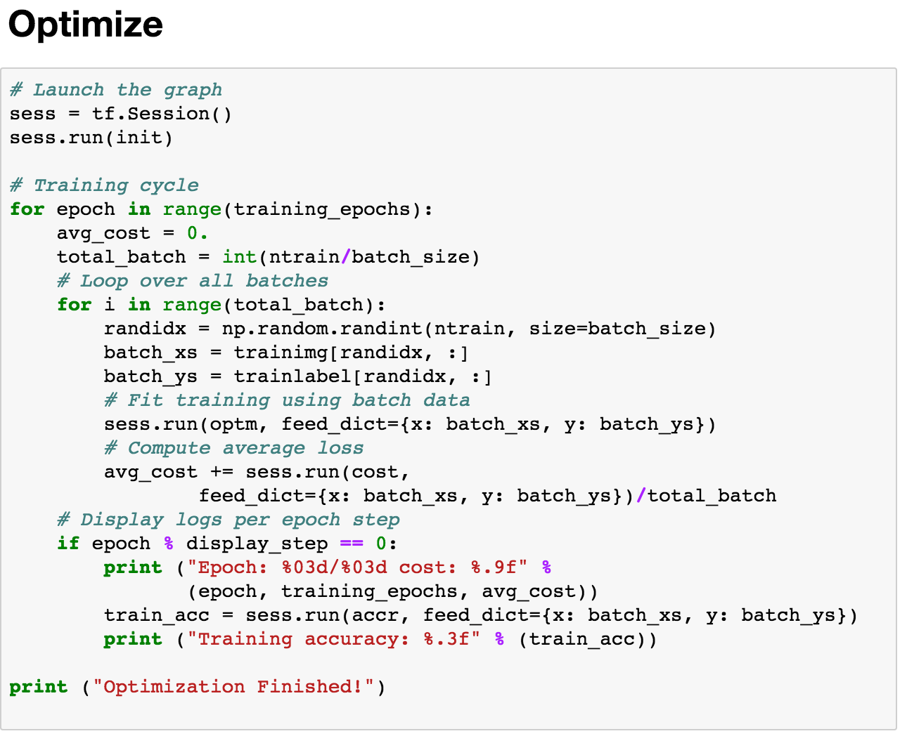
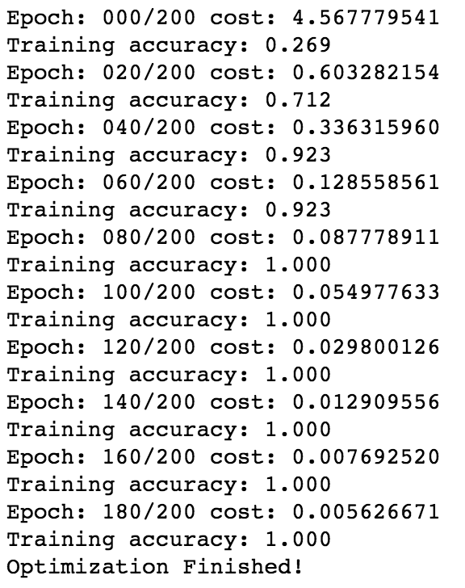
Optimize

Slide 27
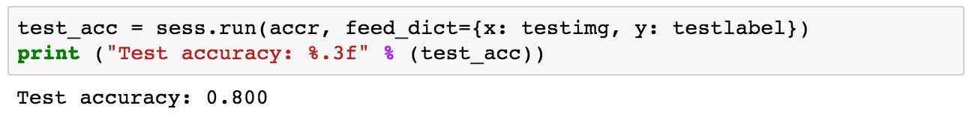
Test accuracy

Slide 28
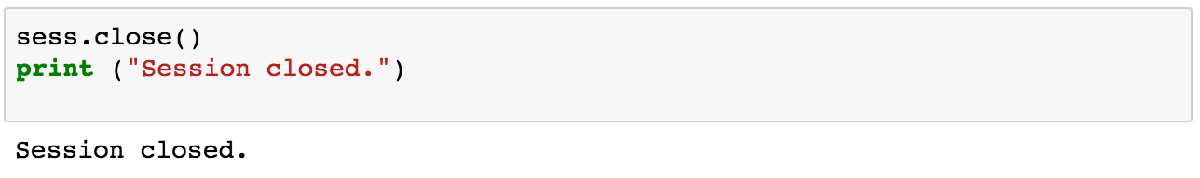
Don’t forget to close

Slide 29
Weight decay?

Slide 30
Convolutional neural net

Slide 31
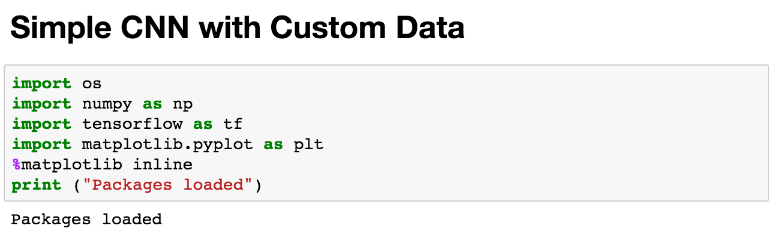
Same as before

Slide 32
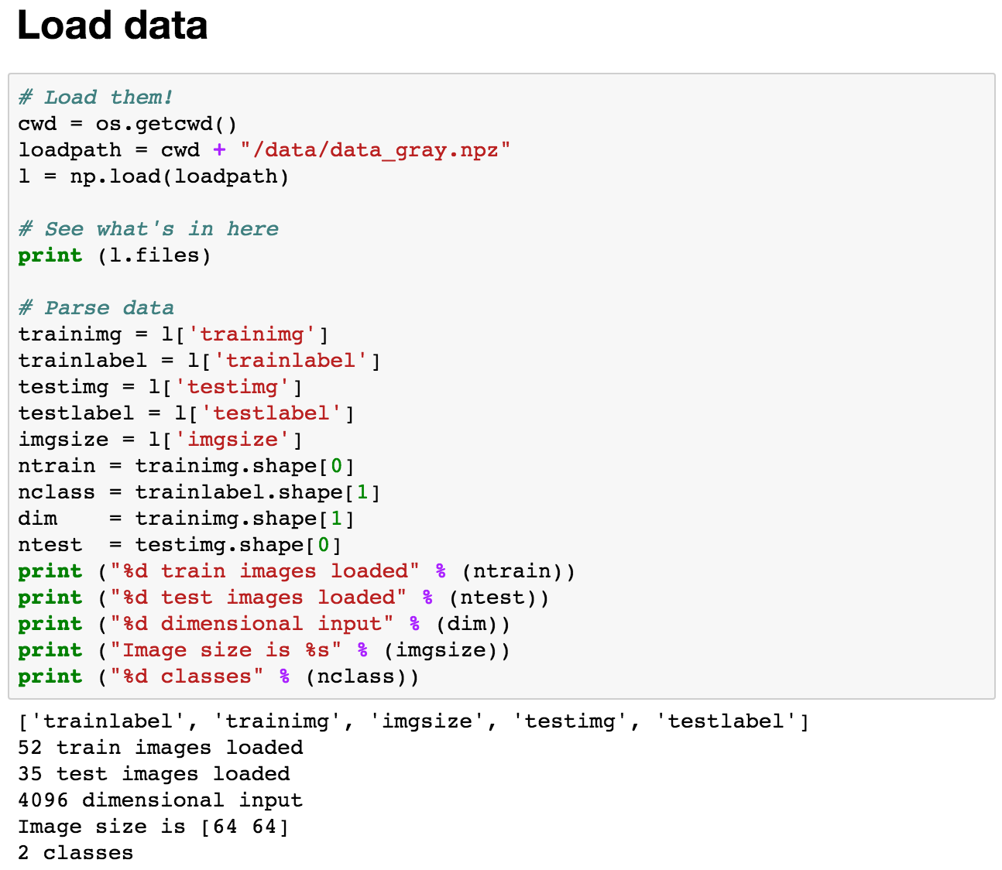
Load

Slide 33
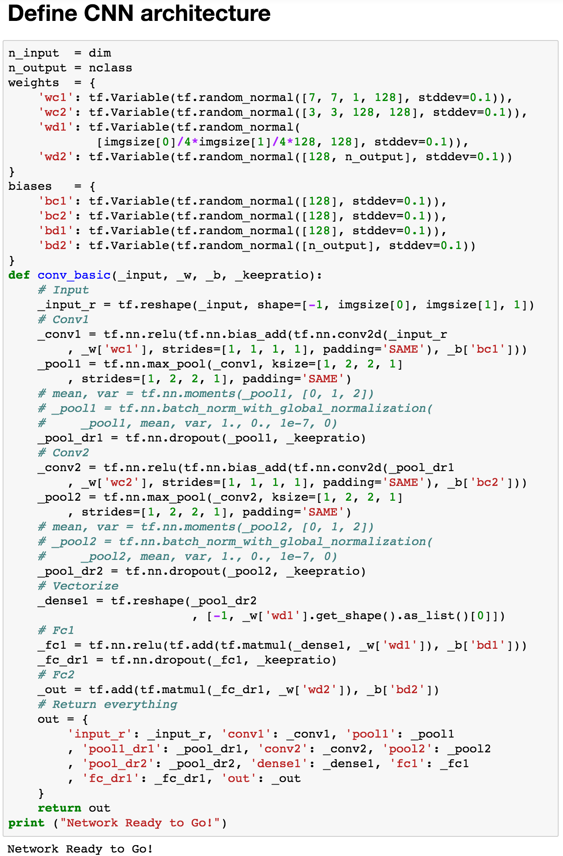
Networks

Slide 34
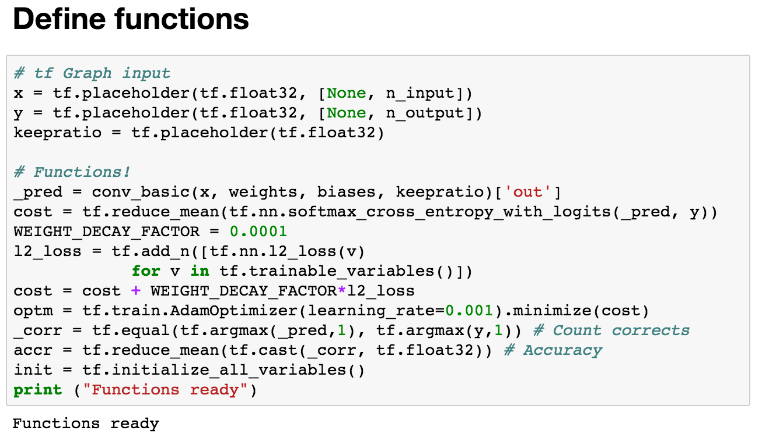
Functions

Slide 35
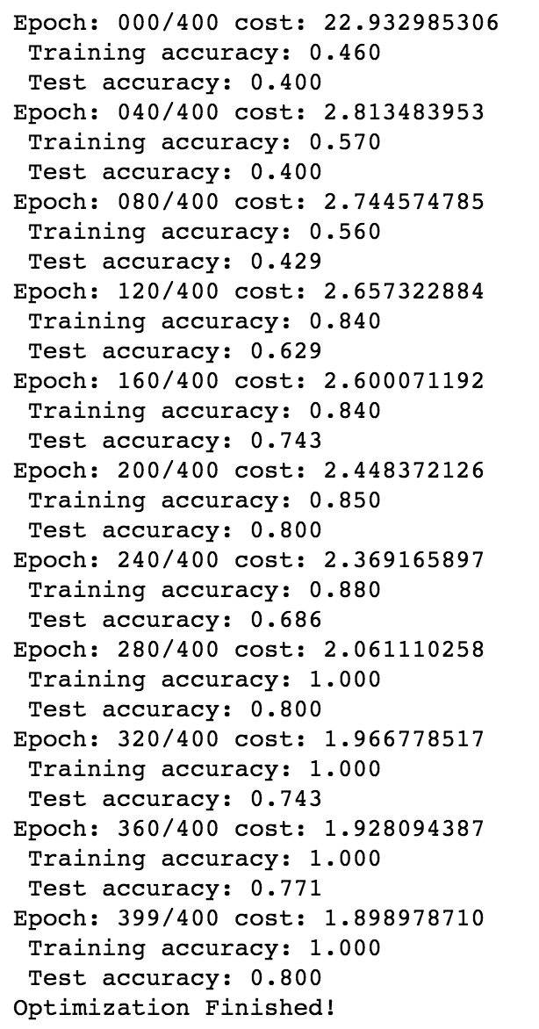
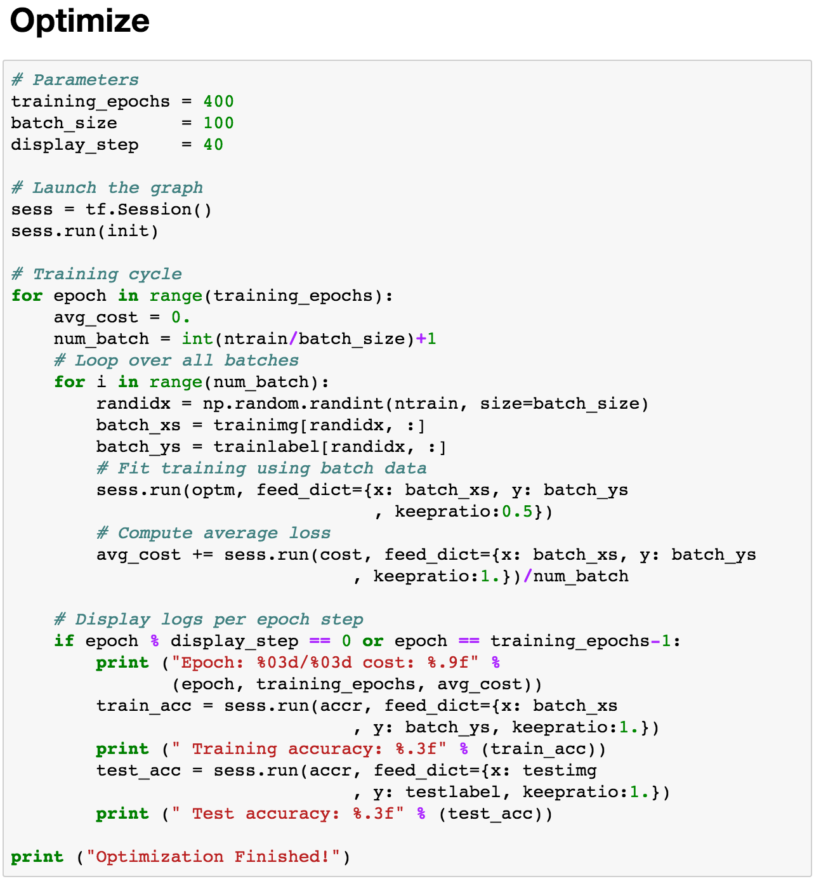
Optimize

